Slide 1

SSZG585 Cross Platform Application Development Assignment
2023mt12202
Anshul Kumari Bansal

Slide 2
Functional Requirements
Users can sign up, sign in, and sign out of the application
Users can create tasks with a Title, Description, and Due Date
Users can mark tasks as complete or incomplete
Users should be able to view all tasks
Users can search task by Title or Description
Users can sort task by due date

Slide 3


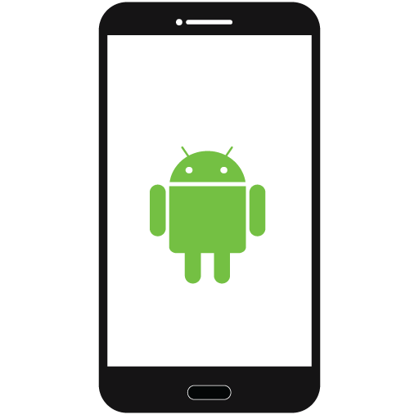
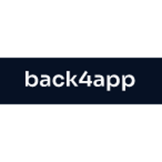


High Level Design
API
Flutter App (Frontend)
Backend as a Service
Client Server Architecture

Slide 4
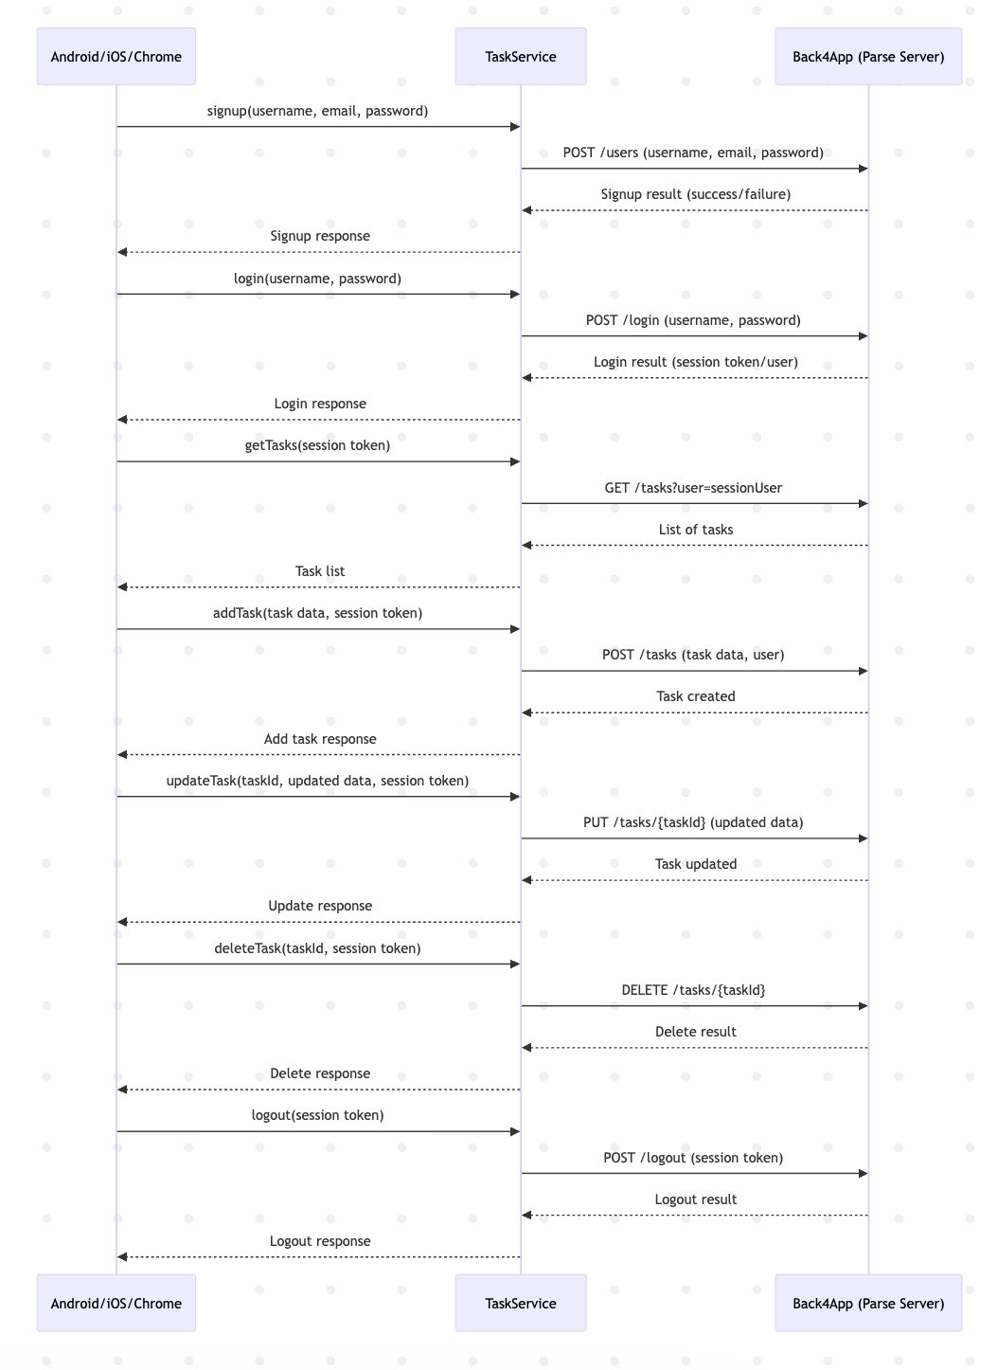
Sequence Diagram

Slide 5
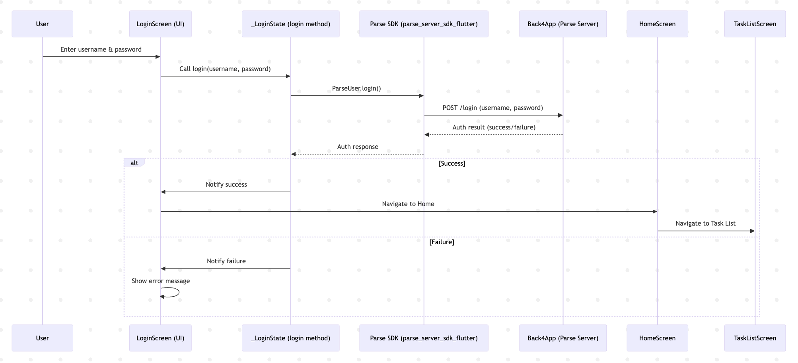
Sequence Diagram – Authentication Flow

Slide 6
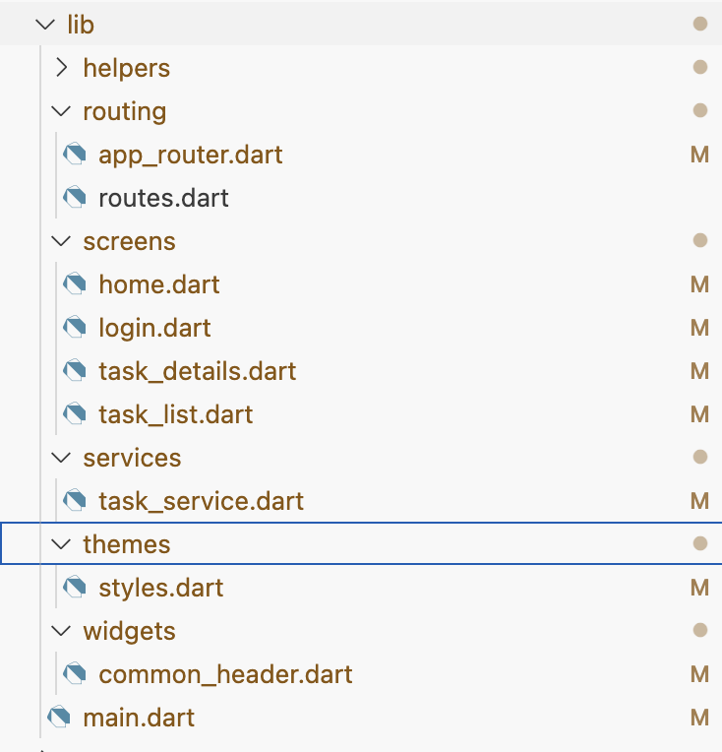
LLD (Structure)
Tools Used for Development
Flutter → Frontend UI, form validation, navigation.
Parse SDK → Handles database interactions and authentication in Flutter.
Back4App → Cloud backend hosting Parse Server.
Dart → Flutter programming language.
Postman (Optional) → To test API requests before integration.
Tools Used
dependencies:
flutter:
sdk: flutter
intl: ^0.19.0
parse_server_sdk_flutter: ^7.0.1
awesome_dialog: ^3.2.0
win32: ^5.5.0
path_provider: ^2.0.0
# The following adds the Cupertino Icons font to your application.
# Use with the CupertinoIcons class for iOS style icons.
cupertino_icons: ^1.0.6
# dependency_overrides:
# win32: 5.4.0
dev_dependencies:
flutter_test:
sdk: flutter
Flutter Dependencies
Main
Home
Signup
Login
Tasks
Task Details
Logout
Auth

Slide 7
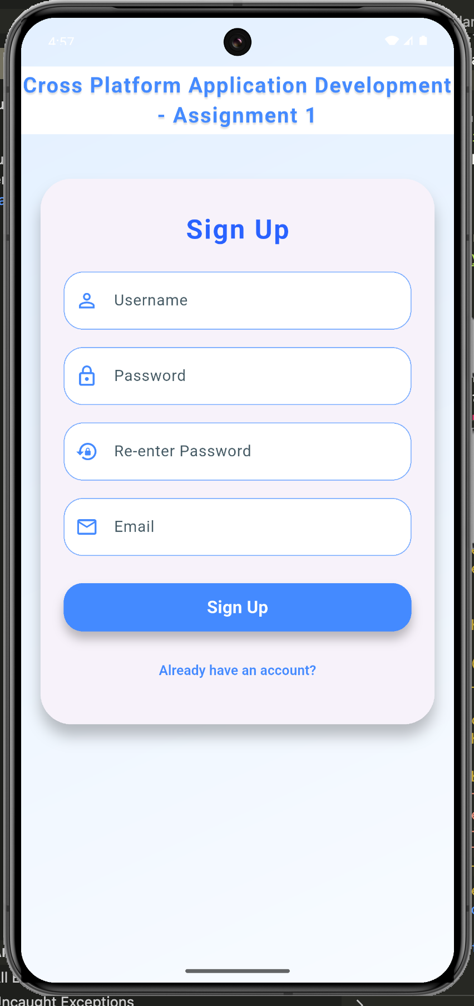
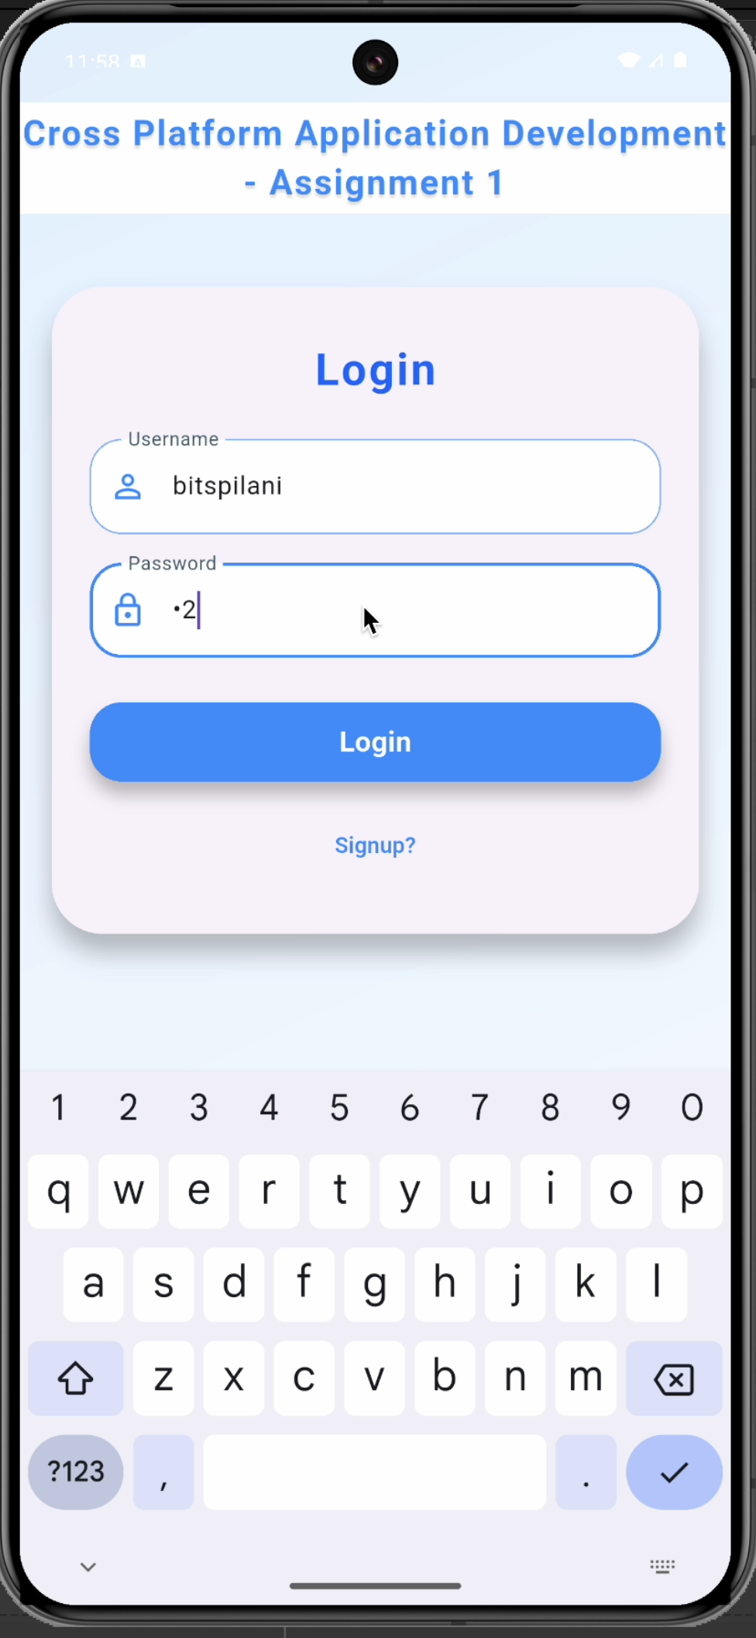
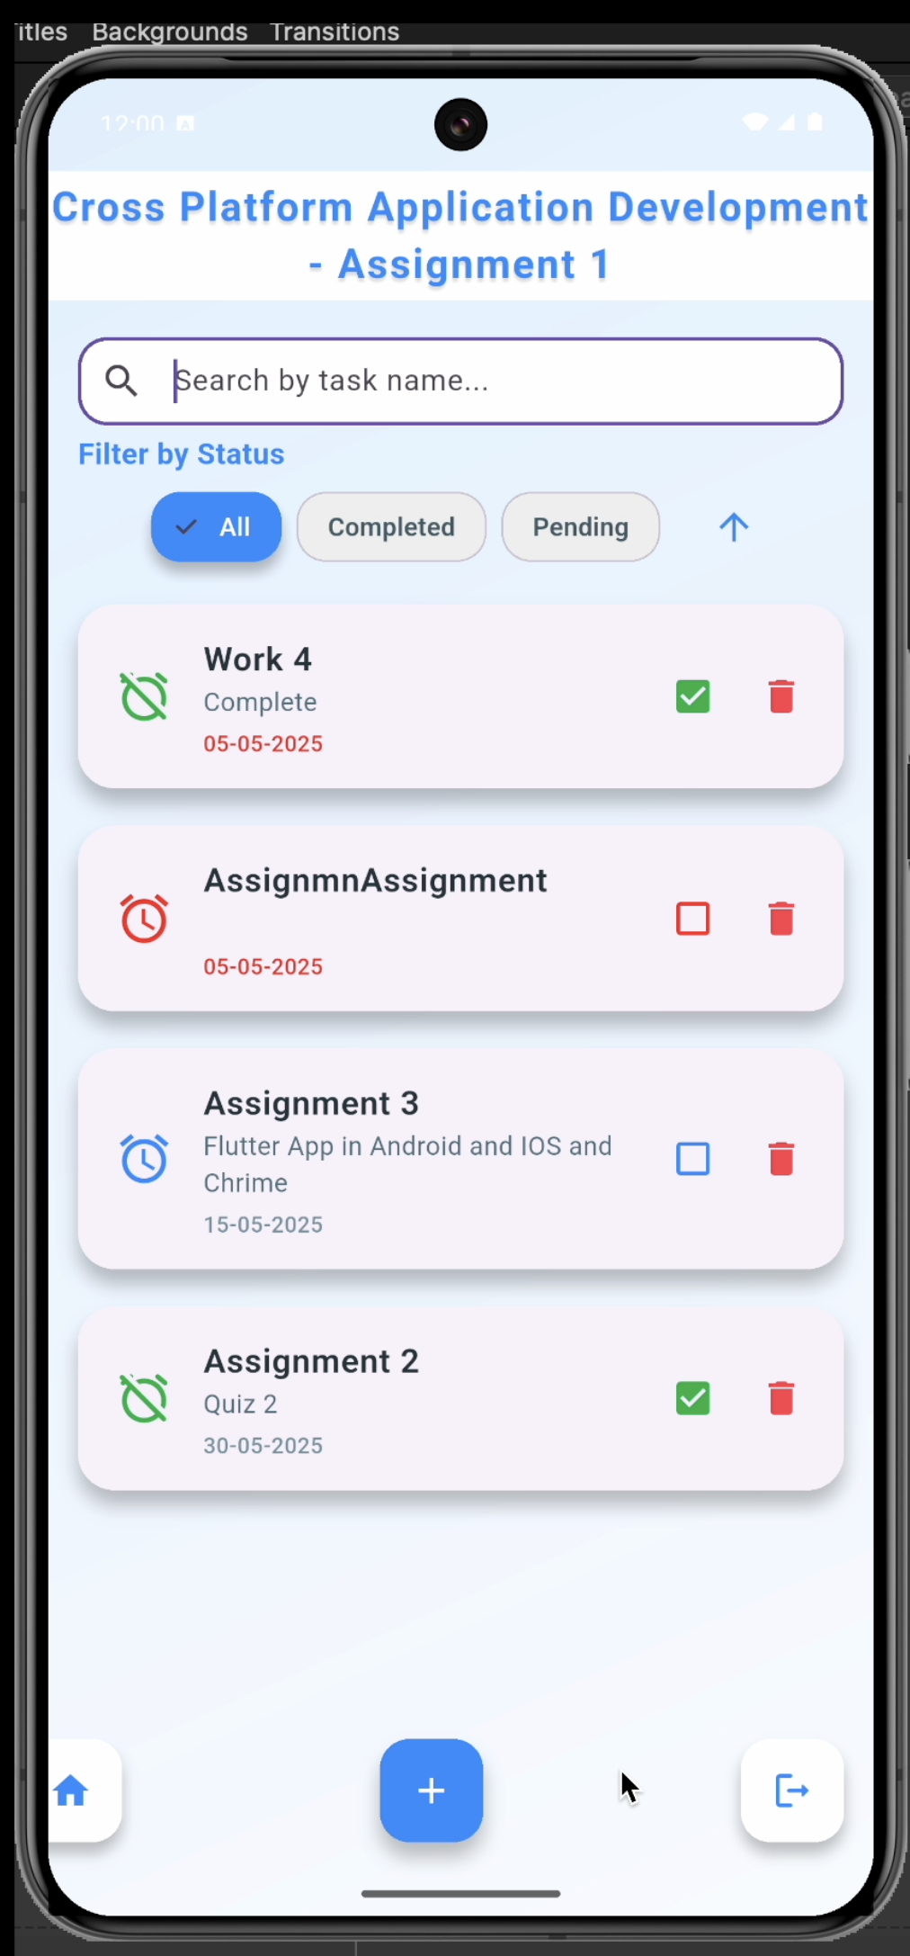
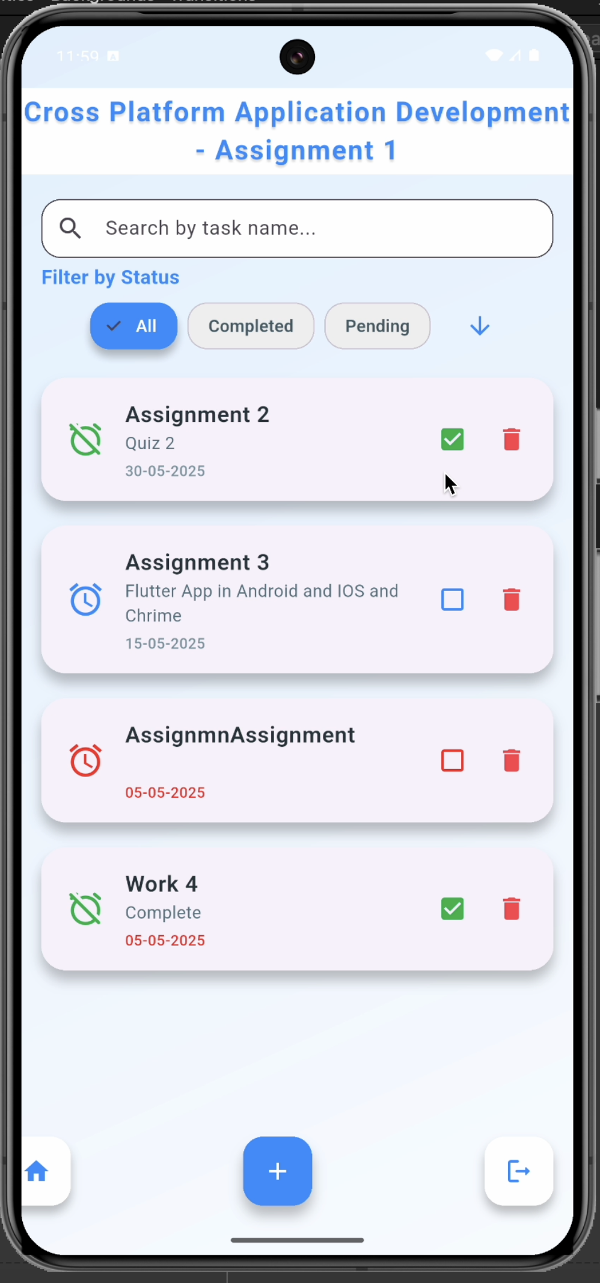
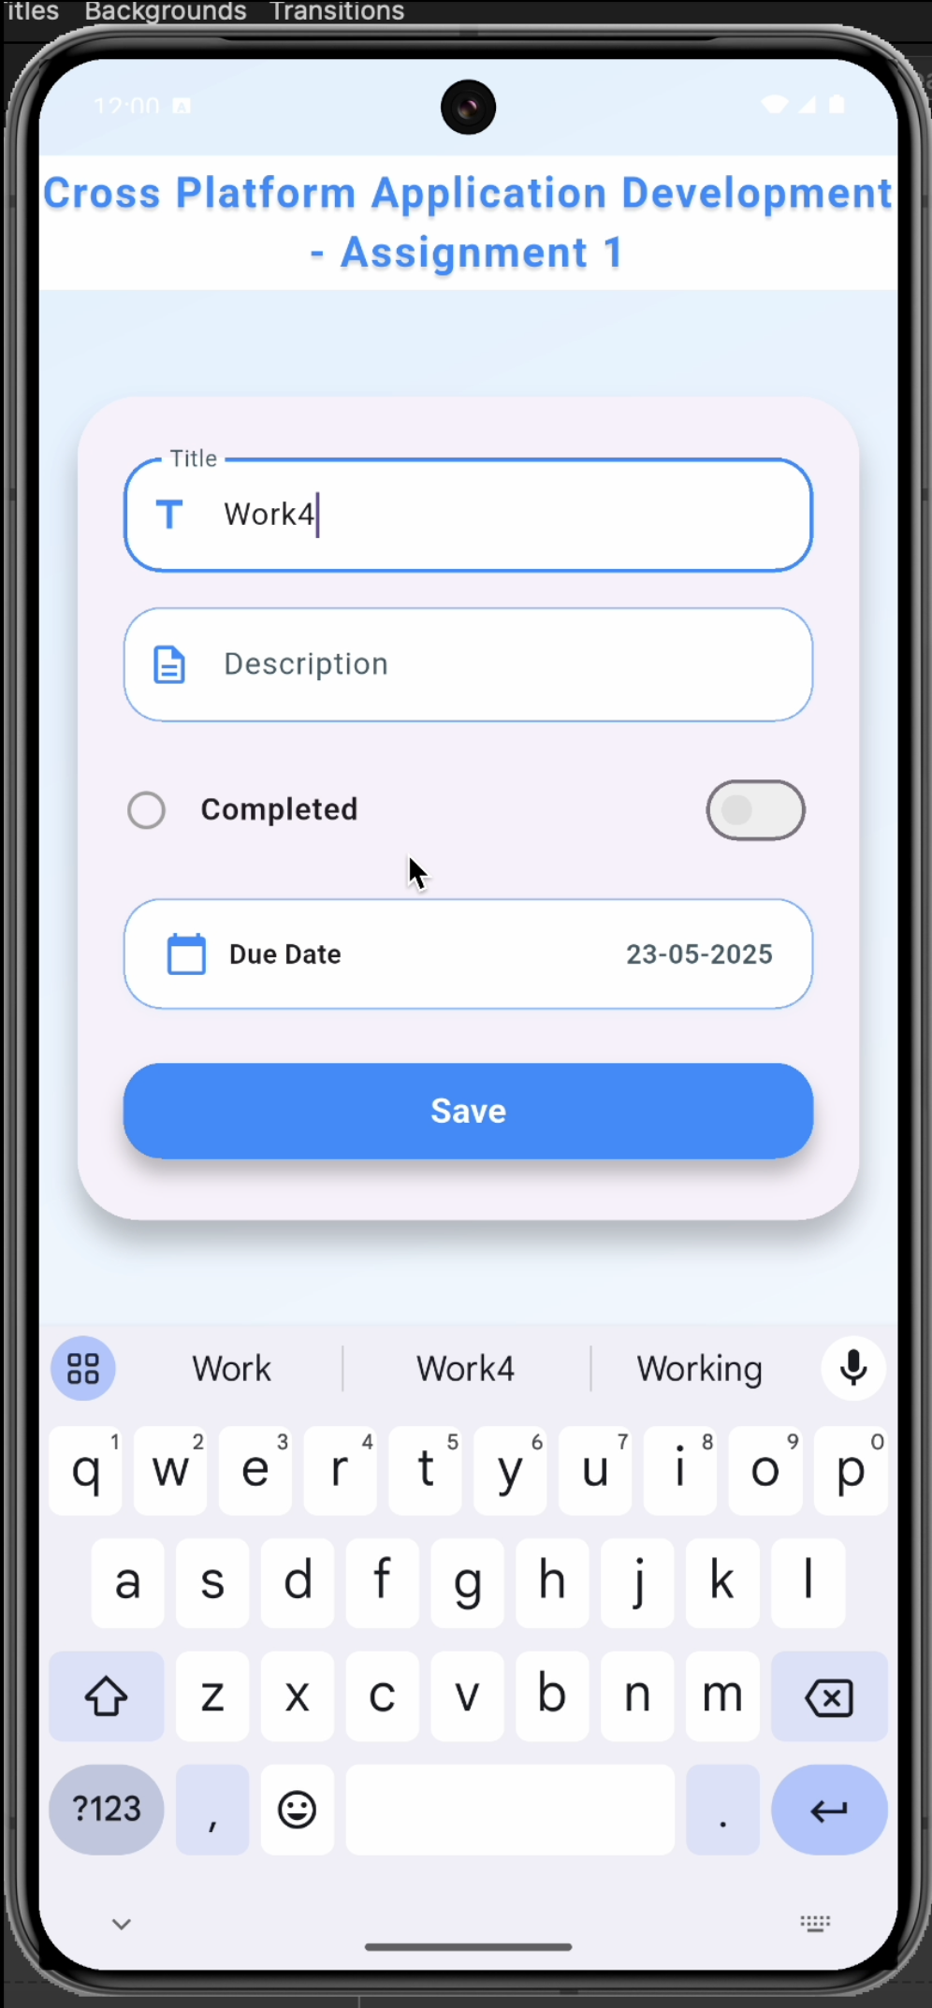
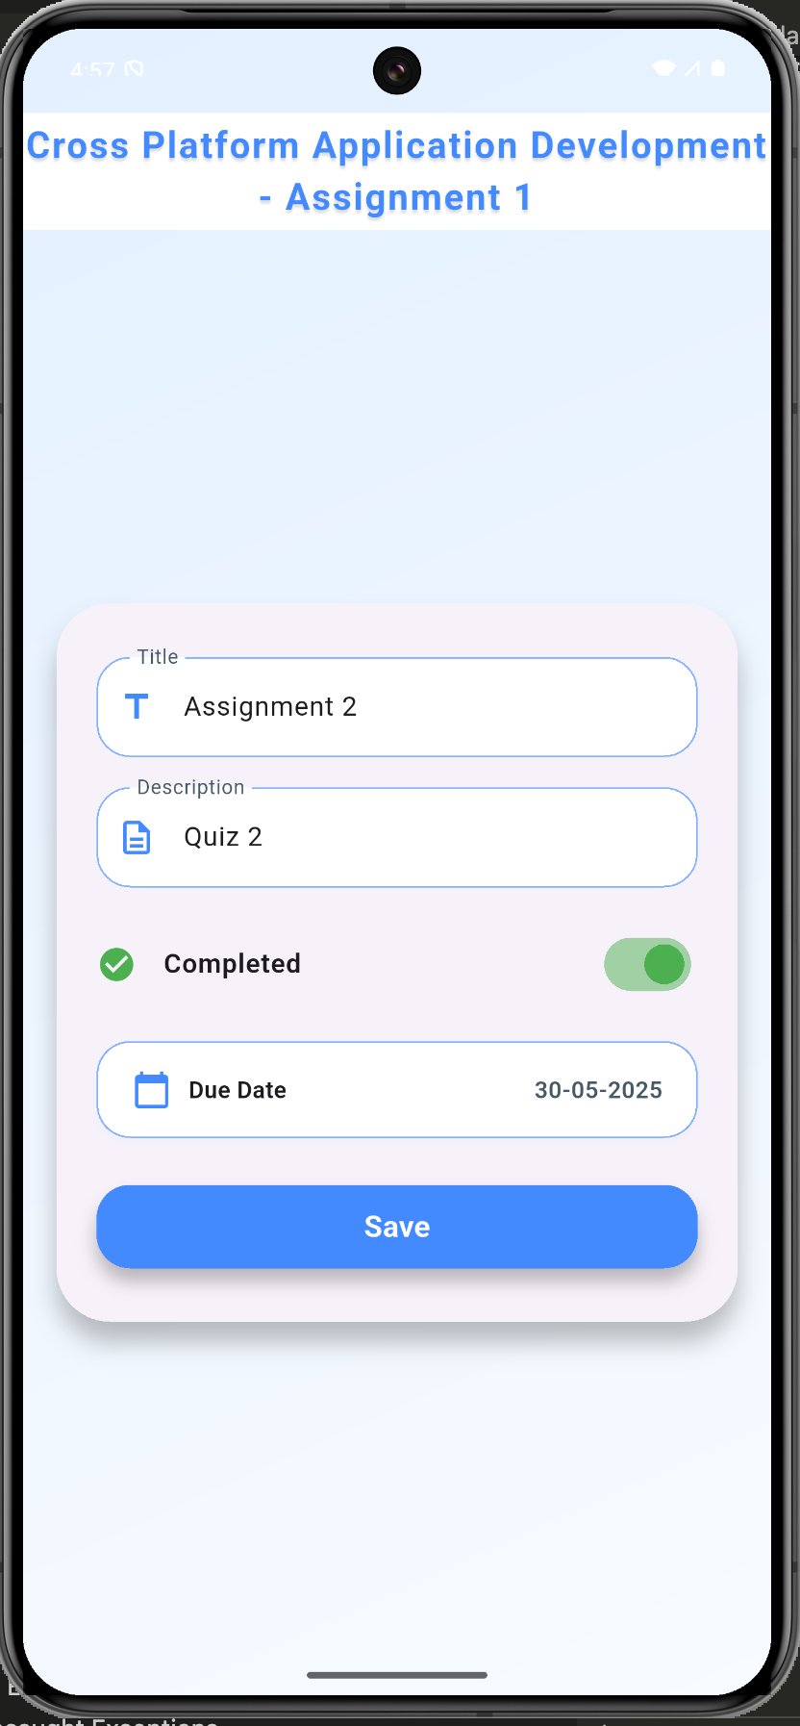
Screenshots
Signup
Login
Logout
Task List with Delete
Add Task
Edit Task

Slide 8
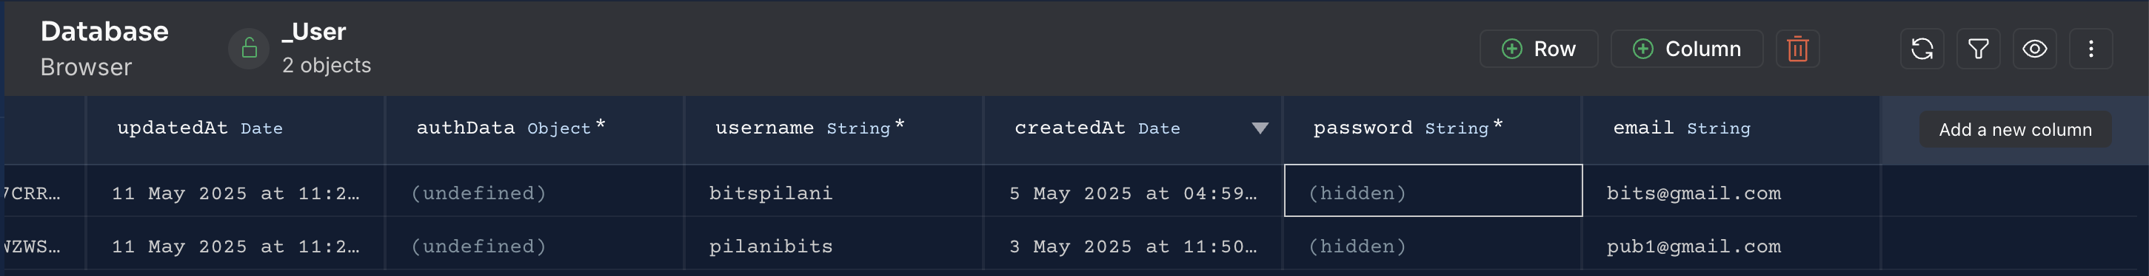
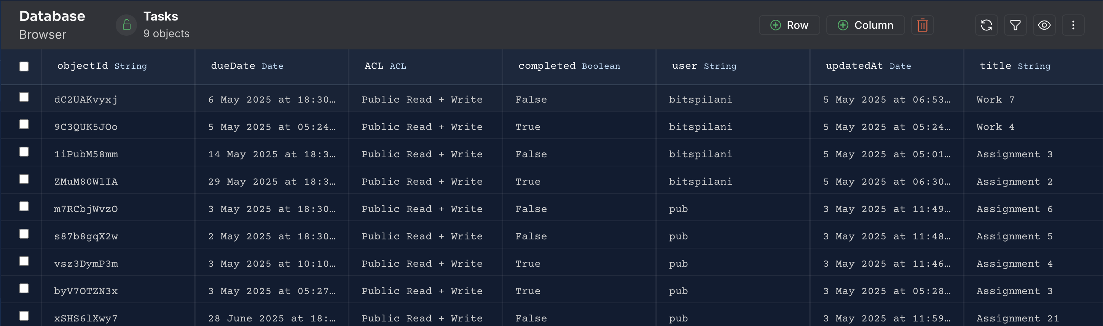
Database Tables Screenshots
User Table
Task Table

Slide 9
Task Card Details
Search and Filter
Task Title
Task Description
Delete Icon
In-completed Future Task
In-complete status Icon
Completed Task
Complete status Icon
In-completed Past Task
Task Card
Add New Task
Home
Logout

Slide 10


Guidelines
Source Code Link
Input validations are implemented to ensure correct user input.
Error messages are displayed at the bottom in red, while success messages appear in green.
Login, Signup, and Logout functionalities are fully implemented.
The Awesome Notifications library is used to provide animated feedback to users.
Demo Youtube Link

Slide 11
Challenges & Learnings
I developed my first cross-platform app using Flutter and Back4App.
During this project I gained knowledge in setting up and utilizing Android emulators and iOS simulators.
I focused on incorporating functional requirements that would enhance the app's utility in my daily life.
Although I faced some limitations due to time constraints, I plan to address these in future updates, including implementing background services for enhanced functionality.
Managing session tokens for authentication continuity was difficult. This was handled by storing the session token locally and using it for API requests

